Slide 1
SINGULAR VALUE DECOMPOSITION - DATA COMPRESSION
N. THAMPIRAJ
RESEARCH SCHOLAR
PSG COLLEGE OF TECHNOLOGY

Slide 2
The objective of the research work is
To discover patterns in data and make predictions based on often complex patterns.
To Implement, analyze and improvise existing learning algorithms, for classification, regression, structured prediction, clustering, etc.
To develop new learning methods.

Slide 3
SCOPE
In the past decade, data explosion is a common phenomenon in several industries like health care, finance, marketing.
Linear algebra and the optimization techniques plays a key role in leveraging the big data to enhance the existing industry by solving various existing problems.

Slide 4
Road Map
Literature Review
Data Compression
Singular Value Decomposition
SVD in Data Compression
References

Slide 5
Literature Review
“Lossy Image Compression using SVD Coding Algorithm”, K. M. Aishwarya, Rachana Ramesh, Preeti. M. Sobarad, Dr. Vipula Singh, 2016, IEEE WiSPNET Conference.
Singular value decomposition is used to compress the image.
Low rank approximation is used to achieve the lossy compression.

Slide 6
Data Compression
Image Compression is the process of reducing the file size of an image while attempting to maintain its visual quality to the greatest extent possible.
Image/video data compression is a very critical technology for many operations
Need fo Data Compression
In satellite images , image compression is used for three main reasons.
First, compression saves space. Satellite receives millions of bits of data each day that require a huge storage facility. By using compression, saves an enormous amount of hard drive space.
Second, image/video compression saves transmission time. Mars Rovers send back pictures and data which can take up to years to send if uncompressed due to the massive distance between Mars and Earth.
Lastly, compression saves money by saving hard drive space and time.

Slide 7
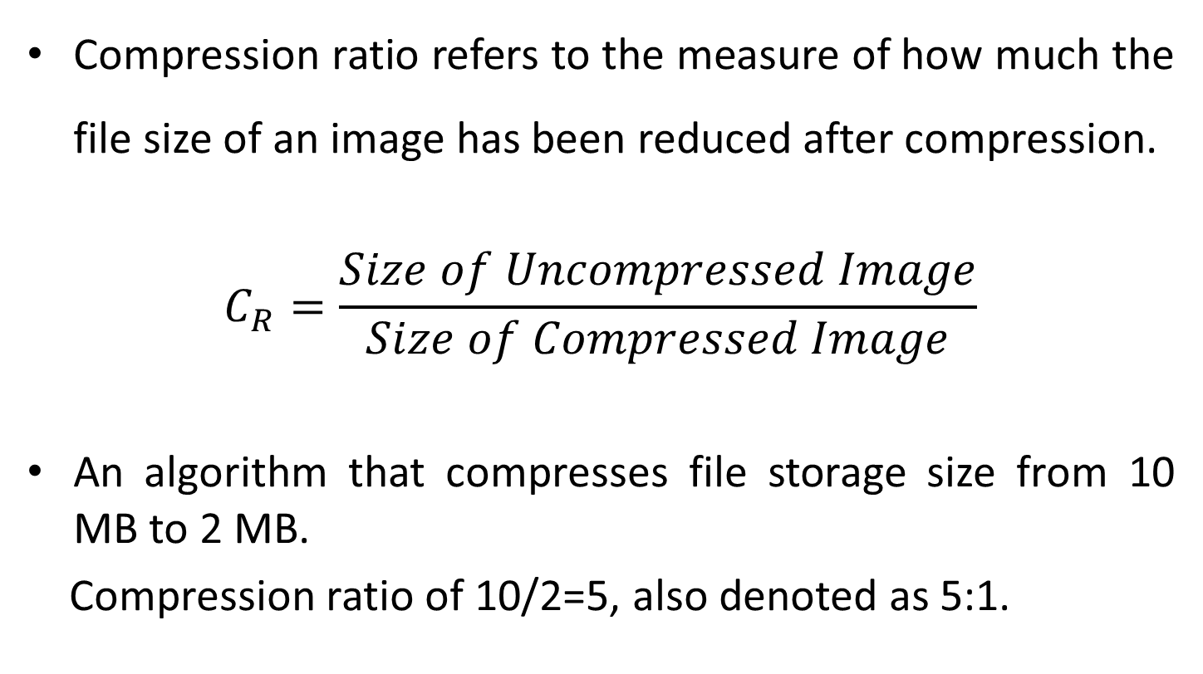
Compression Ratio
Compression ratio refers to the measure of how much the file size of an image has been reduced after compression.
$$C_{R}=\frac{Size of Uncompressed Image}{Size of Compressed Image}$$
An algorithm that compresses file storage size from 10 MB to 2 MB.
Compression ratio of 10/2=5, also denoted as 5:1.

Slide 8
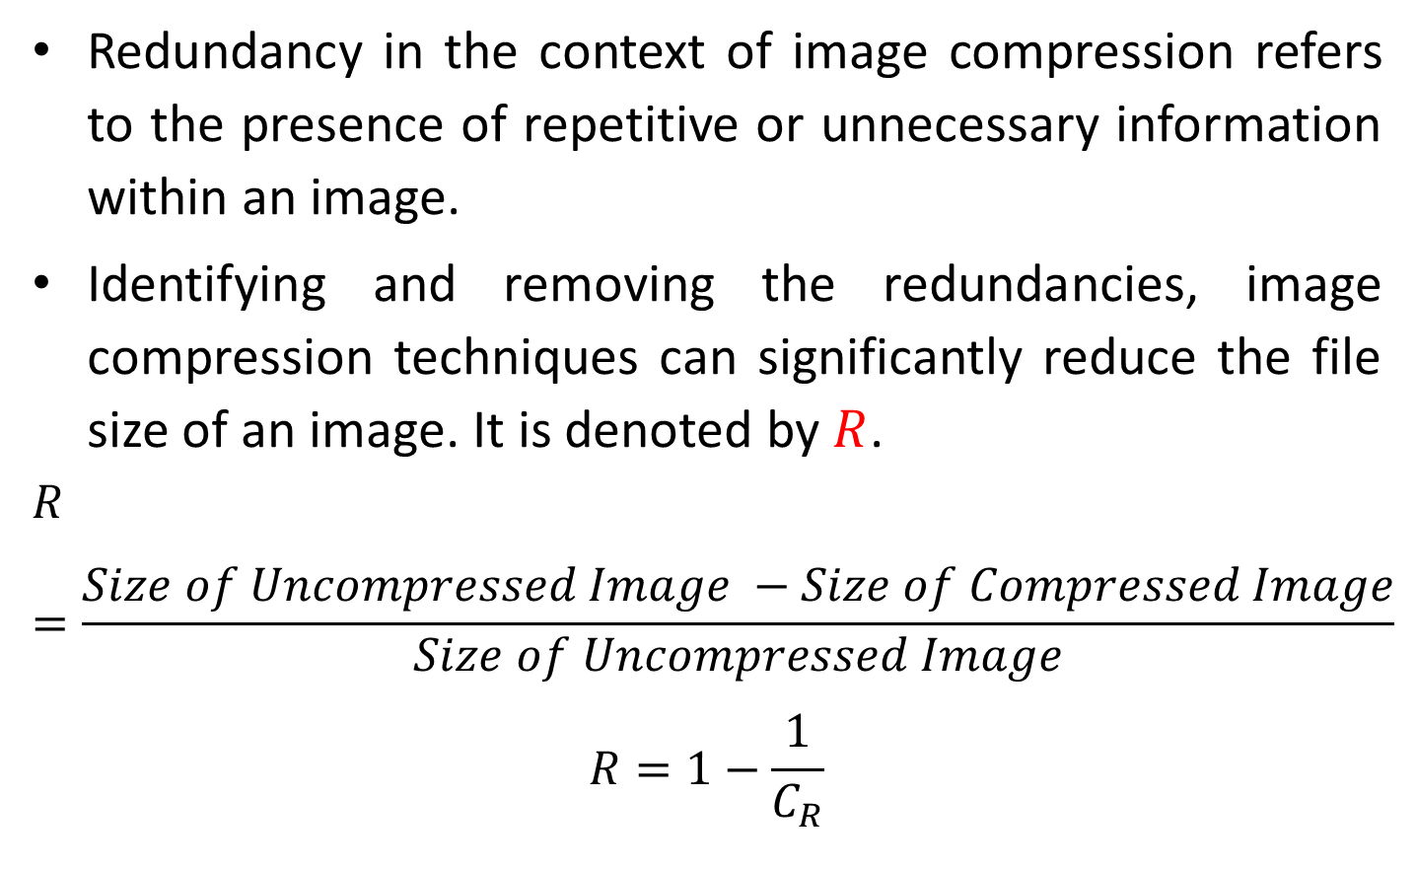
Redundancy in Images
Redundancy in the context of image compression refers to the presence of repetitive or unnecessary information within an image.
Identifying and removing the redundancies, image compression techniques can significantly reduce the file size of an image. It is denoted by $R$.
$$R=\frac{Size of Uncompressed Image −Size of Compressed Image}{Size of Uncompressed Image}$$
$$R=1−\frac{1}{C_{R}}$$

Slide 9
Classifications of Image Compression
Image Compression can be broadly classified into two types:
1. Lossless Compression
2. Lossy Compression
Lossy Compression is a technique used in image compression, where some data is intentionally discarded or approximated in order to achieve higher compression ratios.
The discarded data is typically considered less important or less noticeable to the human senses.

Slide 10
Image Compression Techniques
The following techniques are used for image compression.
Discrete Cosine Transform (DCT)
Discrete Wavelet Transform (DWT)
Singular Value Decomposition (SVD)
Principal Component Analysis (PCA)
Support Vector Machine (SVM)

Slide 11
Singular Value Decomposition (SVD)
Singular Value Decomposition is a matrix factorization technique used to decompose a matrix into three constituent parts, namely the left singular vectors, right singular vectors, and singular values.

Slide 12
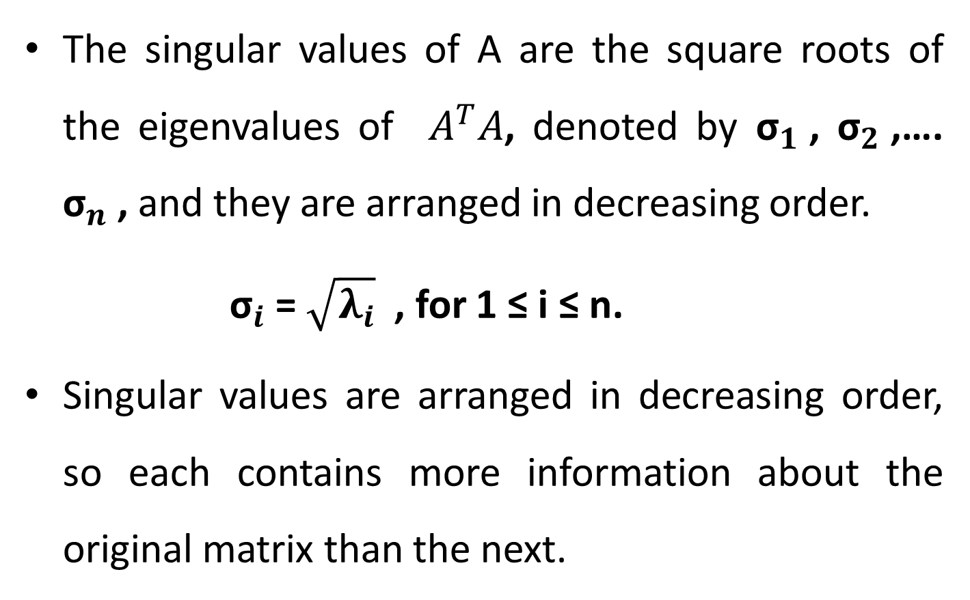
Singular Values
The singular values of A are the square roots of the eigenvalues of $A^{T}A$, denoted by ${\text{σ}}_{1}$, ${\text{σ}}_{2}$,…. ${\text{σ}}_{n}$, and they are arranged in decreasing order.
${\text{σ}}_{i}$= $\sqrt{λ_{i}}$ , for 1 ≤ i ≤ n.
Singular values are arranged in decreasing order, so each contains more information about the original matrix than the next.

Slide 13
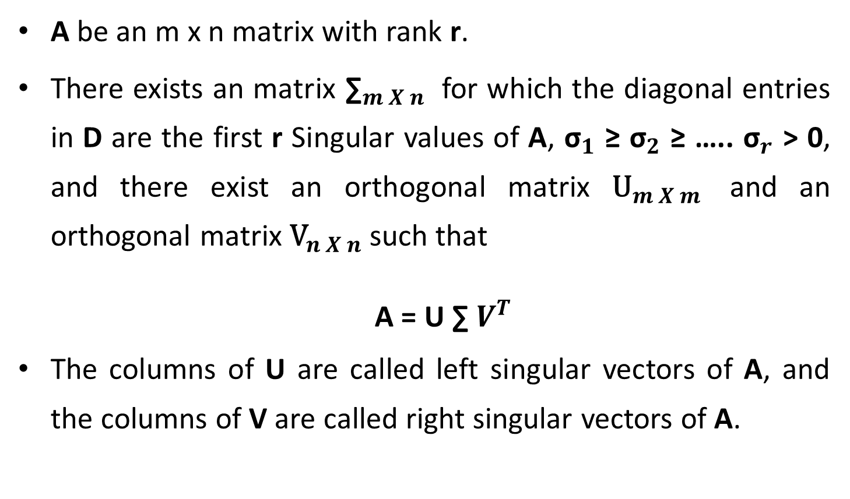
Singular Value Decomposition
A be an m x n matrix with rank r.
There exists an matrix ${\text{∑}}_{m X n}$ for which the diagonal entries in D are the first r Singular values of A, ${\text{σ}}_{1}$ ≥ ${\text{σ}}_{2}$ ≥ ….. ${\text{σ}}_{r}$ > 0, and there exist an orthogonal matrix ${\text{U}}_{m X m}$ and an orthogonal matrix ${\text{V}}_{n X n}$ such that
A = U ∑ $V^{T}$
The columns of U are called left singular vectors of A, and the columns of V are called right singular vectors of A.

Slide 14
Counting the number of pivot columns in A is the general method to find the rank of A.
In SVD, rank of a large matrix A is obtained by counting the number of nonzero singular values.
Extremely small nonzero singular values are assumed to be zero and the effective rank of the matrix is obtained by counting the remaining number of nonzero singular values.

Slide 15
Singular Value Decomposition in Recommender System
Recommender Systems are software tools and techniques providing suggestions for items to be of use to a user.
The suggestions related to various decision – making processes :
what items to buy
what music to listen
what movies to watch
The primary application of recommender systems is finding a relationship between user and products in order to maximize the user-product engagement.

Slide 16

Singular Value Decomposition for Movie Recommendation
User / Movies | Sci-Fi 1 | Sci-Fi 2 | Sci-Fi 3 | Comedy 1 | Comedy 2
User 1 | 1 | 1 | 1 | 0 | 0
User 2 | 3 | 3 | 3 | 0 | 0
User 3 | 4 | 4 | 4 | 0 | 0
User 4 | 5 | 5 | 5 | 0 | 0
User 5 | 0 | 2 | 0 | 4 | 4
User 6 | 0 | 0 | 0 | 5 | 5
User 7 | 0 | 1 | 0 | 2 | 2
$$A=\left[\begin{matrix}1 & 1 & 1 & 0 & 0 \\ 3 & 3 & 3 & 0 & 0 \\ 4 & 4 & 4 & 0 & 0 \\ 5 & 5 & 5 & 0 & 0 \\ 0 & 2 & 0 & 4 & 4 \\ 0 & 0 & 0 & 5 & 5 \\ 0 & 1 & 0 & 2 & 2\end{matrix}\right]$$

Slide 17
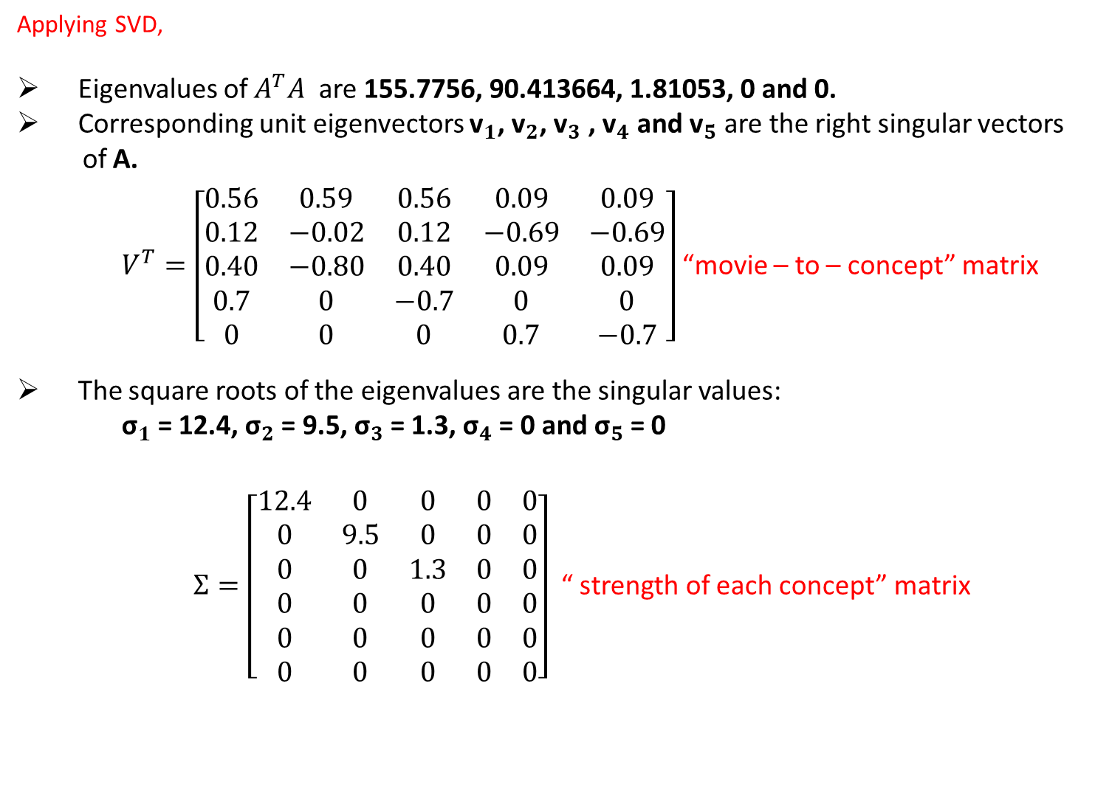
Applying SVD,
Eigenvalues of $A^{T}A$ are 155.7756, 90.413664, 1.81053, 0 and 0.
Corresponding unit eigenvectors ${\text{v}}_{1}$, ${\text{v}}_{2}$, ${\text{v}}_{3}$ , ${\text{v}}_{4}$ and ${\text{v}}_{5}$ are the right singular vectors
of A.
$V^{T}=\left[\begin{matrix}0.56 & 0.59 & 0.56 & 0.09 & 0.09 \\ 0.12 & −0.02 & 0.12 & −0.69 & −0.69 \\ 0.40 & −0.80 & 0.40 & 0.09 & 0.09 \\ 0.7 & 0 & −0.7 & 0 & 0 \\ 0 & 0 & 0 & 0.7 & −0.7\end{matrix}\right]$ “movie – to – concept” matrix
The square roots of the eigenvalues are the singular values:
${\text{σ}}_{1}$= 12.4, ${\text{σ}}_{2}$= 9.5, ${\text{σ}}_{3}$= 1.3, ${\text{σ}}_{4}$= 0 and ${\text{σ}}_{5}$= 0
$Ʃ=\left[\begin{matrix}12.4 & 0 & 0 & 0 & 0 \\ 0 & 9.5 & 0 & 0 & 0 \\ 0 & 0 & 1.3 & 0 & 0 \\ 0 & 0 & 0 & 0 & 0 \\ 0 & 0 & 0 & 0 & 0 \\ 0 & 0 & 0 & 0 & 0\end{matrix}\right]$ “ strength of each concept” matrix

Slide 18
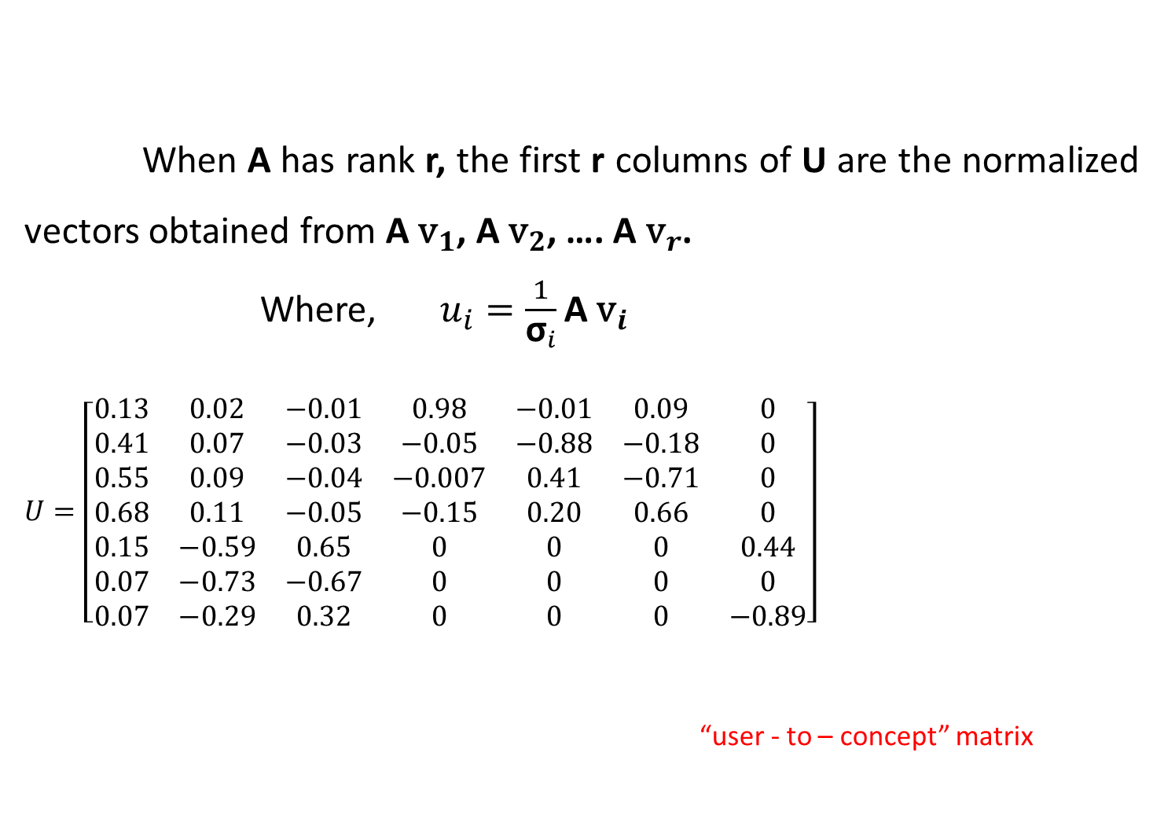
When A has rank r, the first r columns of U are the normalized vectors obtained from A ${\text{v}}_{1}$, A ${\text{v}}_{2}$, …. A ${\text{v}}_{r}$.
Where, $u_{i}=\frac{1}{{\text{σ}}_{i}}\text{A} {\text{v}}_{i}$
$U=\left[\begin{matrix}0.13 & 0.02 & −0.01 & 0.98 & −0.01 & 0.09 & 0 \\ 0.41 & 0.07 & −0.03 & −0.05 & −0.88 & −0.18 & 0 \\ 0.55 & 0.09 & −0.04 & −0.007 & 0.41 & −0.71 & 0 \\ 0.68 & 0.11 & −0.05 & −0.15 & 0.20 & 0.66 & 0 \\ 0.15 & −0.59 & 0.65 & 0 & 0 & 0 & 0.44 \\ 0.07 & −0.73 & −0.67 & 0 & 0 & 0 & 0 \\ 0.07 & −0.29 & 0.32 & 0 & 0 & 0 & −0.89\end{matrix}\right]$
“user - to – concept” matrix

Slide 19
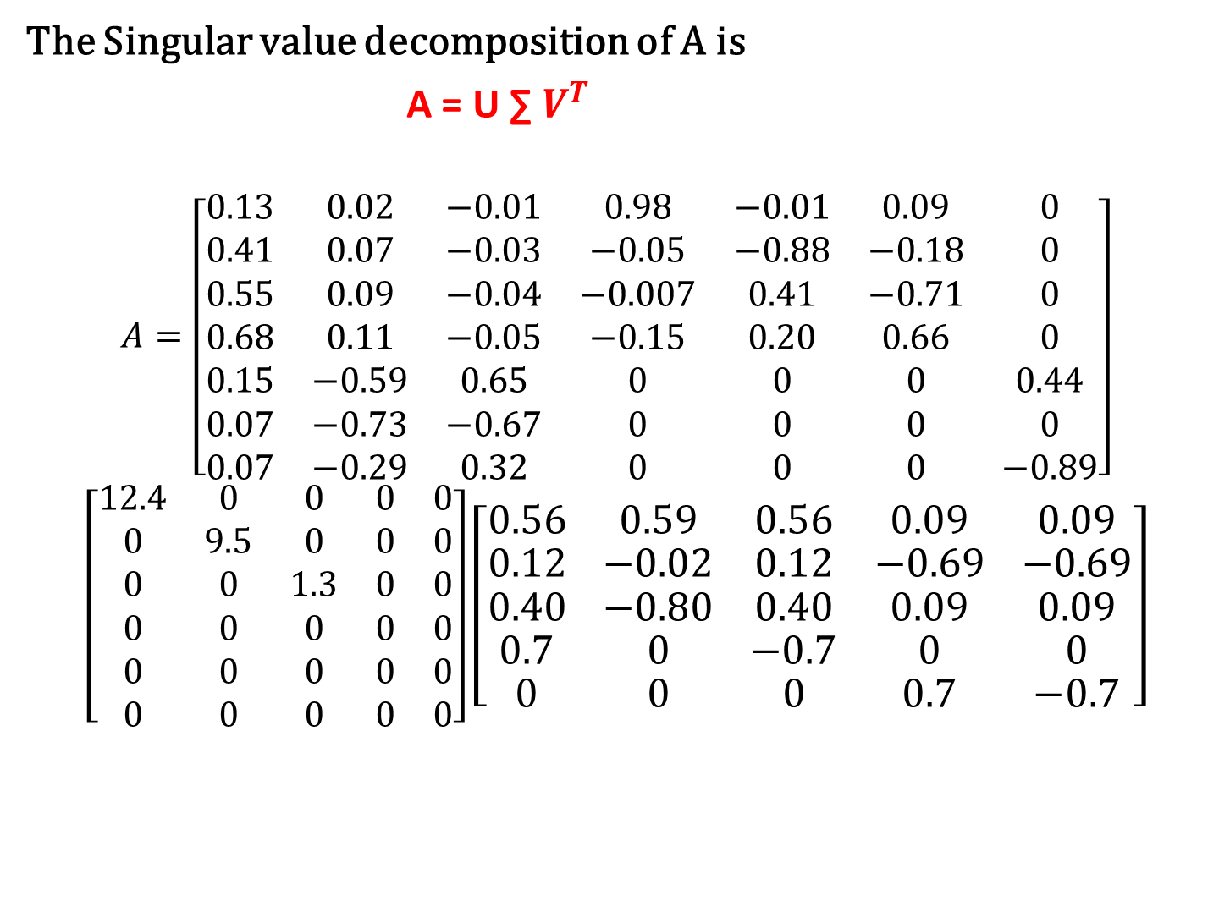
The Singular value decomposition of A is
A = U ∑ $V^{T}$
$$A=\left[\begin{matrix}0.13 & 0.02 & −0.01 & 0.98 & −0.01 & 0.09 & 0 \\ 0.41 & 0.07 & −0.03 & −0.05 & −0.88 & −0.18 & 0 \\ 0.55 & 0.09 & −0.04 & −0.007 & 0.41 & −0.71 & 0 \\ 0.68 & 0.11 & −0.05 & −0.15 & 0.20 & 0.66 & 0 \\ 0.15 & −0.59 & 0.65 & 0 & 0 & 0 & 0.44 \\ 0.07 & −0.73 & −0.67 & 0 & 0 & 0 & 0 \\ 0.07 & −0.29 & 0.32 & 0 & 0 & 0 & −0.89\end{matrix}\right]$$
$$\left[\begin{matrix}12.4 & 0 & 0 & 0 & 0 \\ 0 & 9.5 & 0 & 0 & 0 \\ 0 & 0 & 1.3 & 0 & 0 \\ 0 & 0 & 0 & 0 & 0 \\ 0 & 0 & 0 & 0 & 0 \\ 0 & 0 & 0 & 0 & 0\end{matrix}\right]\left[\begin{matrix}0.56 & 0.59 & 0.56 & 0.09 & 0.09 \\ 0.12 & −0.02 & 0.12 & −0.69 & −0.69 \\ 0.40 & −0.80 & 0.40 & 0.09 & 0.09 \\ 0.7 & 0 & −0.7 & 0 & 0 \\ 0 & 0 & 0 & 0.7 & −0.7\end{matrix}\right]$$

Slide 20

How is SVD Decomposition used to compress data?
Given matrix A(of rank m), what is the closest matrix ${\text{A}}_{k}$ (of rank r<m) to A?
$$A=UƩV^{T}=\sum_{i=1}^{r}{u_{i}σ_{i}{v_{i}}^{T}}$$
$A_{k} =u_{1}σ_{1}{v_{1}}^{T}$+ $u_{2}σ_{2}{v_{2}}^{T}+…+u_{k}σ_{k}{v_{k}}^{T}$

Slide 21
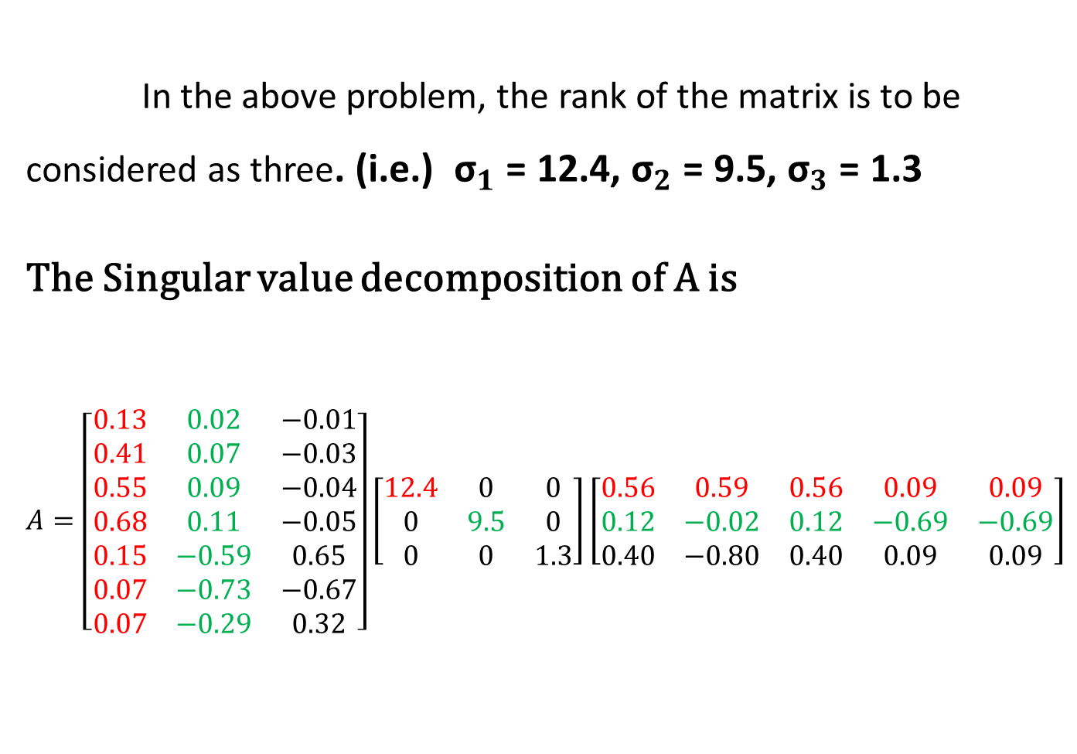
In the above problem, the rank of the matrix is to be considered as three. (i.e.) ${\text{σ}}_{1}$= 12.4, ${\text{σ}}_{2}$= 9.5, ${\text{σ}}_{3}$= 1.3
The Singular value decomposition of A is
$$A=\left[\begin{matrix}0.13 & 0.02 & −0.01 \\ 0.41 & 0.07 & −0.03 \\ 0.55 & 0.09 & −0.04 \\ 0.68 & 0.11 & −0.05 \\ 0.15 & −0.59 & 0.65 \\ 0.07 & −0.73 & −0.67 \\ 0.07 & −0.29 & 0.32\end{matrix}\right]\left[\begin{matrix}12.4 & 0 & 0 \\ 0 & 9.5 & 0 \\ 0 & 0 & 1.3\end{matrix}\right]\left[\begin{matrix}0.56 & 0.59 & 0.56 & 0.09 & 0.09 \\ 0.12 & −0.02 & 0.12 & −0.69 & −0.69 \\ 0.40 & −0.80 & 0.40 & 0.09 & 0.09\end{matrix}\right]$$

Slide 22
Converting a Image into Pixel Form
A black and white ‘cameraman’ photograph is scanned as a rectangular array of pixels and then stored as a matrix ‘img’ by assigning each pixel a numerical value in accordance with its gray level.
The entries in the matrix would be integers between 0 and 255.
Consider the size of the matrix ‘img’ is 256 X 256, then it will take 65,536 mega pixels to store the image.

Slide 23
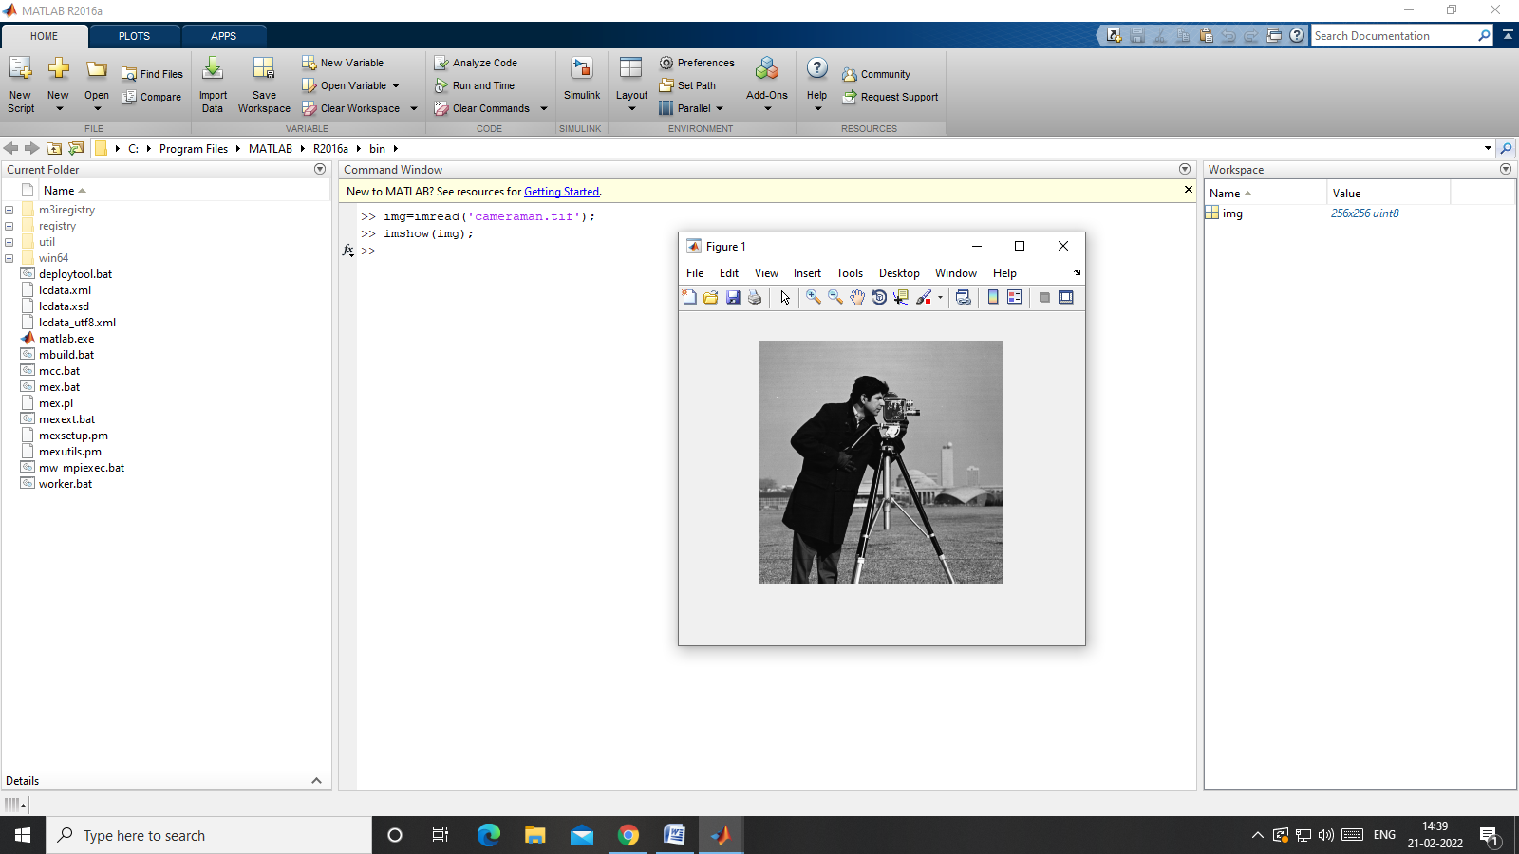
Original Image

Slide 24
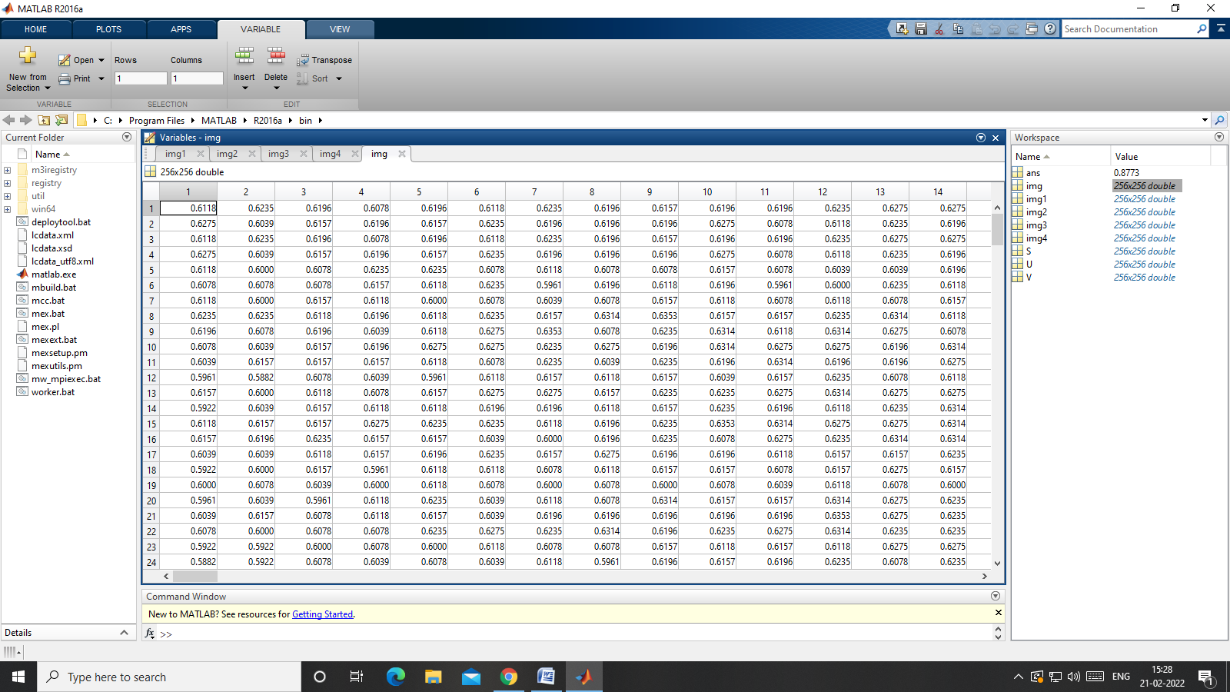
Pixel Values

Slide 25
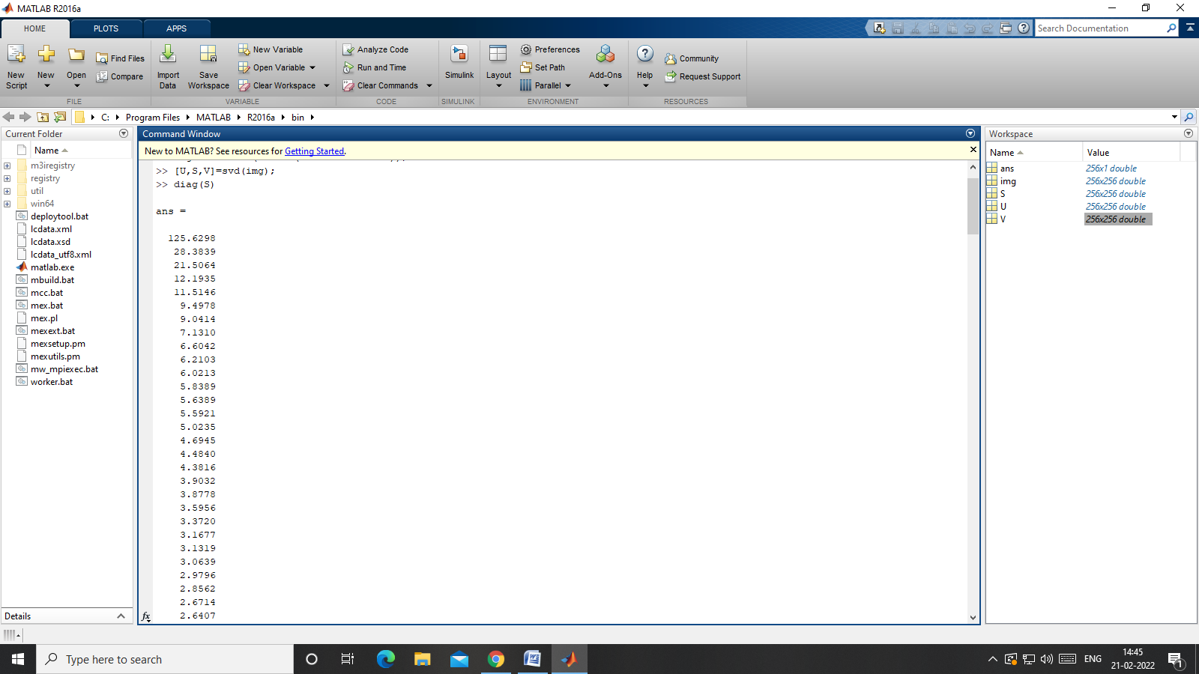
Singular Value Decomposition

Slide 26
“Cameraman” image with 256 X 256 pixels takes 65,536 mega pixels to store the image.
Using Low-Rank k approximation (Reduced SVD) with different ranks.
(i). Rank(A) = 1
(ii). Rank (A) = 2
(iii). Rank (A) = 50
(iv). Rank (A) = 80

Slide 27
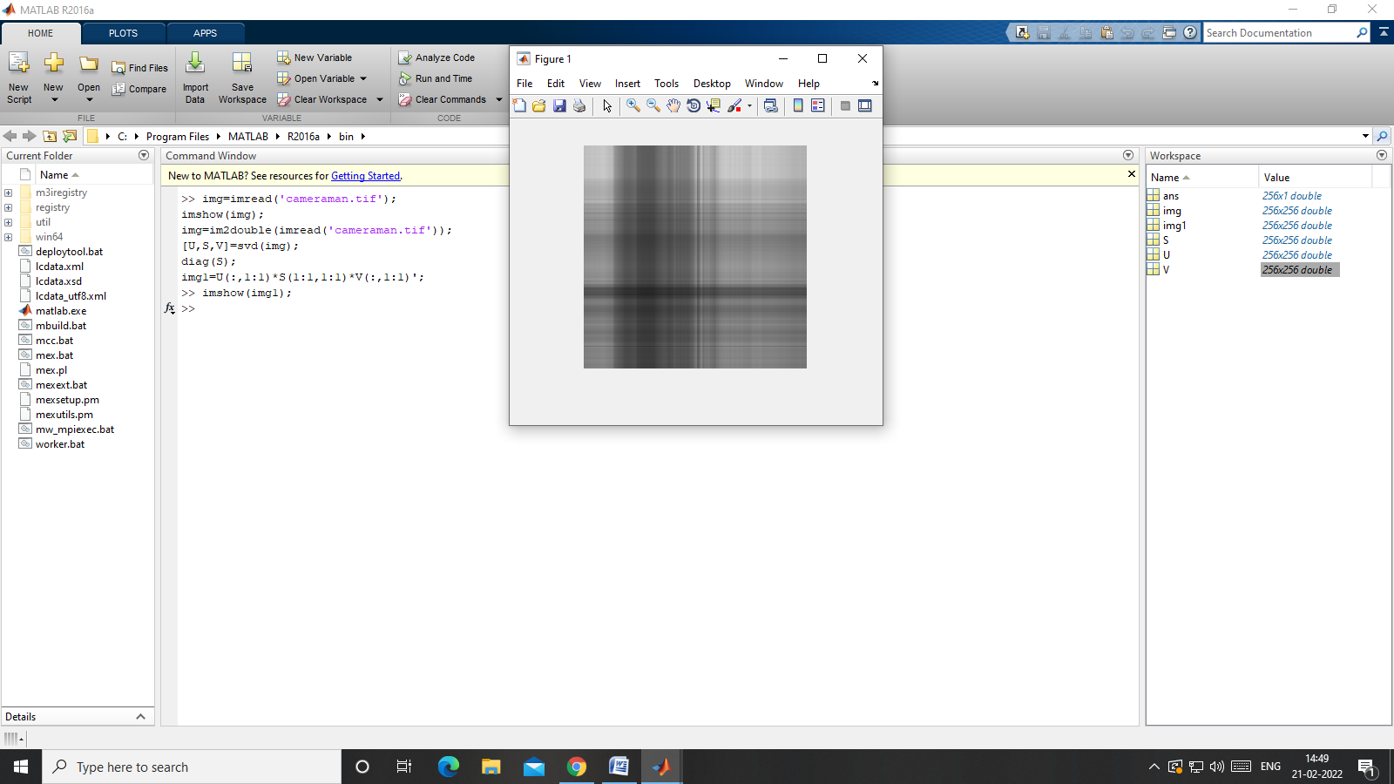
Rank(img) = 1, (k=1)

Slide 28
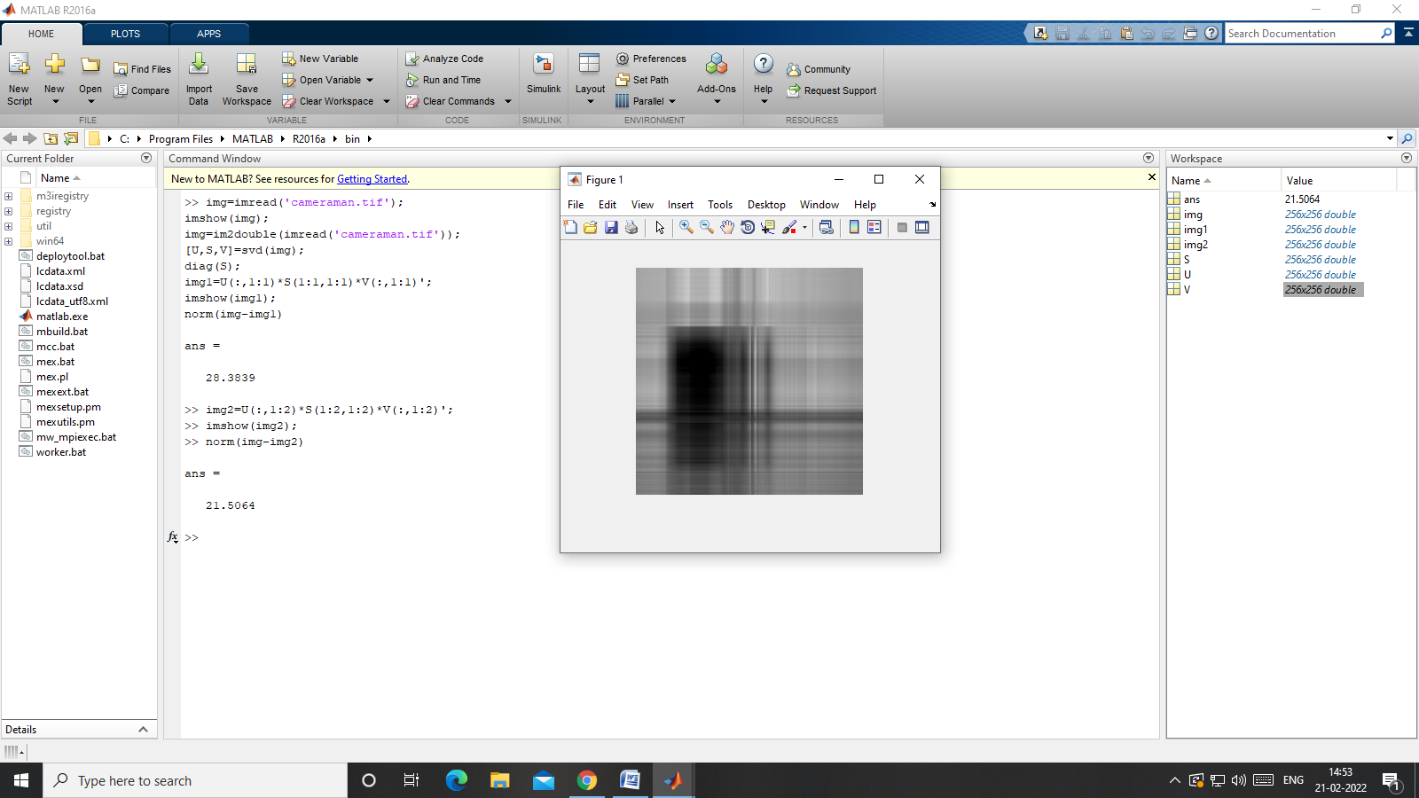
Rank(img) = 2, (k=2)

Slide 29
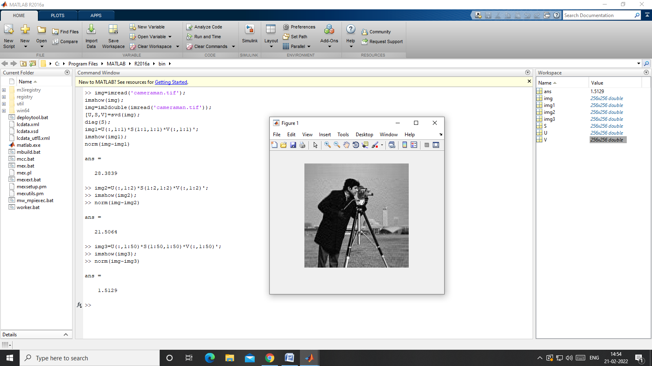
Rank(img) = 50, (k=50)

Slide 30
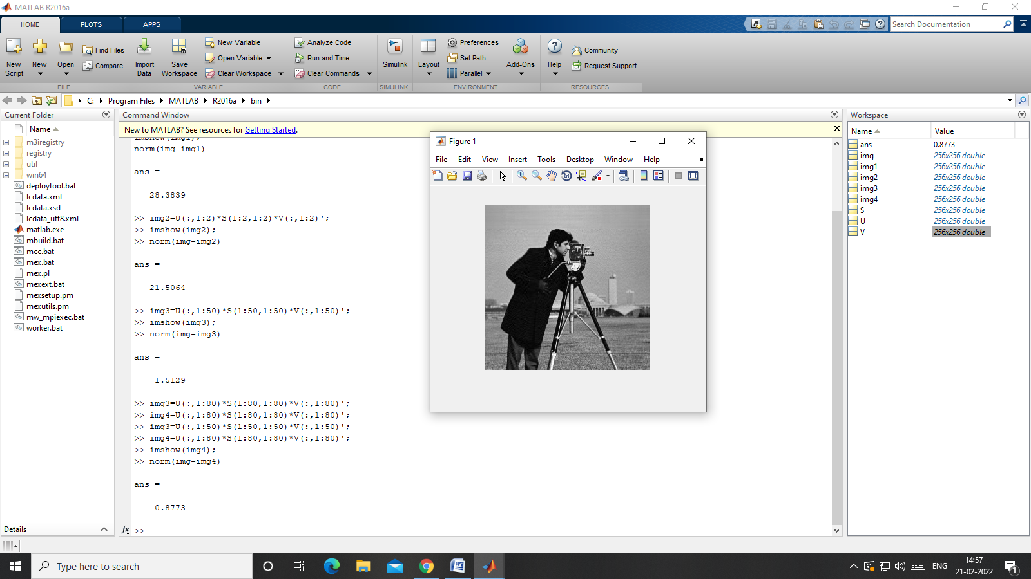
Rank(img) = 80, (k=80)

Slide 31
Quality of Compressed Image
The quality of a compressed image refers to how closely it resembles the original uncompressed image.
It is a measure of how much information has been retained or lost during the compression process.
Following methods are used to measure the quality of the compressed image.
Euclidean Norm
Root Mean Square Error (RMSE)
Signal to Noise Ratio (SNR)
Peak Signal to Noise Ratio (PSNR)

Slide 32
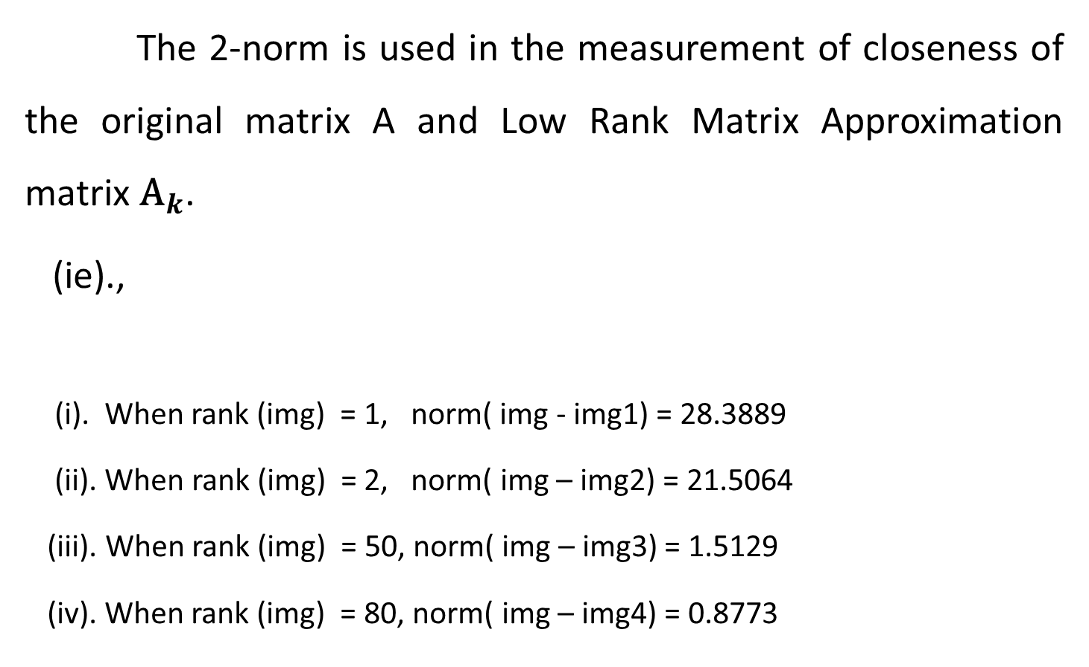
Euclidean Norm
The 2-norm is used in the measurement of closeness of the original matrix A and Low Rank Matrix Approximation matrix ${\text{A}}_{k}$.
(ie).,
(i). When rank (img) = 1, norm( img - img1) = 28.3889
(ii). When rank (img) = 2, norm( img – img2) = 21.5064
(iii). When rank (img) = 50, norm( img – img3) = 1.5129
(iv). When rank (img) = 80, norm( img – img4) = 0.8773

Slide 33
References

Slide 34
THANK YOU

Slide 35
Matrix Factorization
Matrix Factorization refers to the process of
expressing a matrix as a product of two or more
matrices.

Slide 36
Types of Matrix Factorization
There are many different types of matrix
factorizations, but some of the most common
include:
LU Factorization
QR Factorization
Singular Value Decomposition (SVD)
Eigen Decomposition

Slide 37
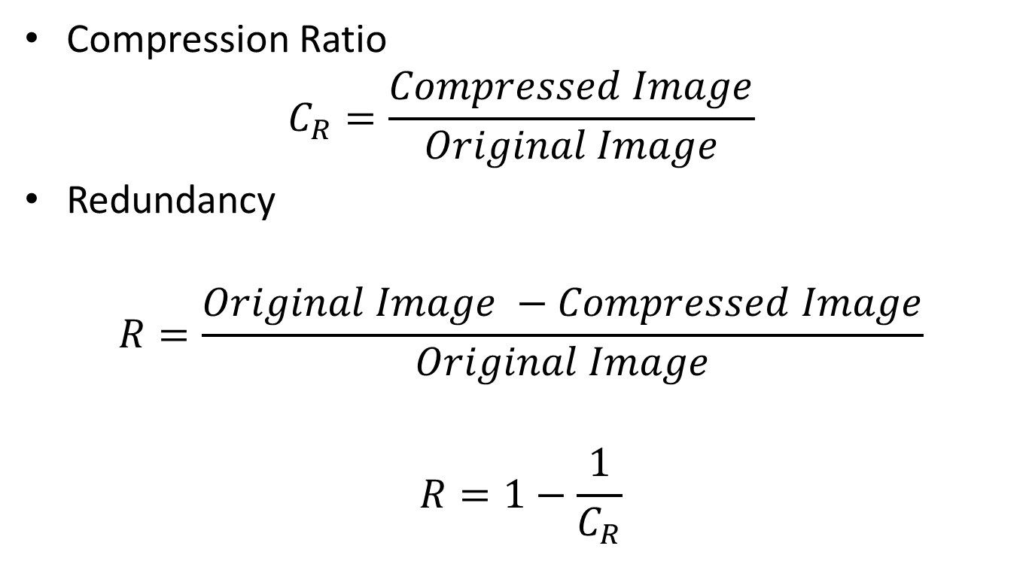
Performance of Compression
Compression Ratio
$$C_{R}=\frac{Compressed Image}{Original Image}$$
Redundancy
$$R=\frac{Original Image −Compressed Image}{Original Image}$$
$$R=1−\frac{1}{C_{R}}$$

Slide 38
Low – Rank Matrix Approximation
All Singular values are arranged in descending order on the ∑ matrix.
The first singular value on the diagonal ∑ matrix contains the greatest amount of information and subsequent singular values contain decreasing amounts of information.
Lower SV’s contains negligible amount of information.

Slide 39



Slide 40
The Singular Value Decomposition has a wide
range of applications, including
Data Compression
Image Processing
Signal Processing
Recommender System

Slide 41
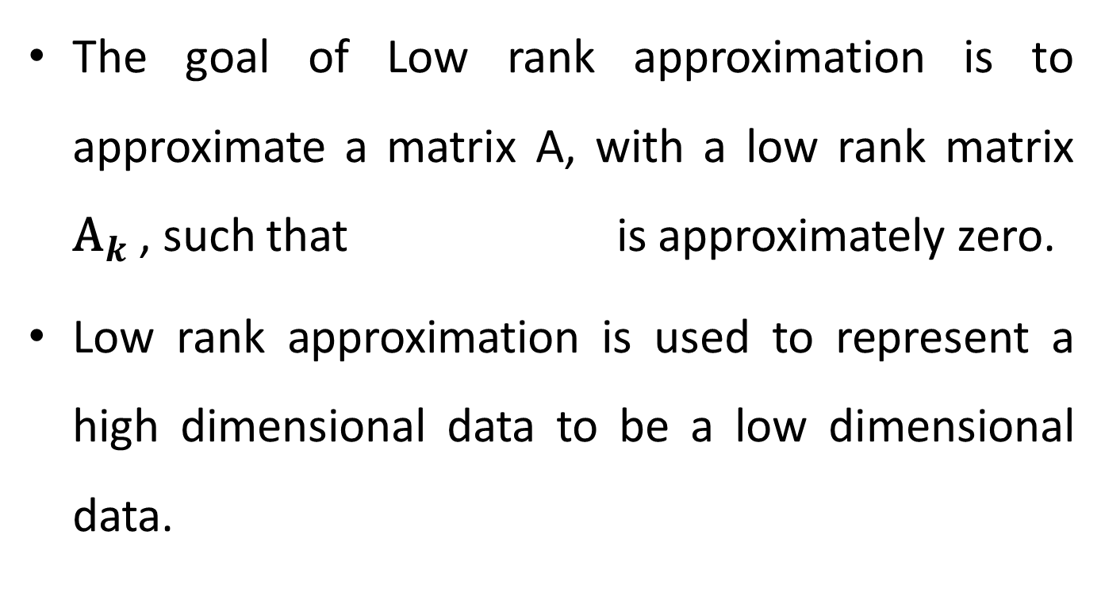
The goal of Low rank approximation is to approximate a matrix A, with a low rank matrix ${\text{A}}_{k}$ , such that is approximately zero.
Low rank approximation is used to represent a high dimensional data to be a low dimensional data.

Slide 42
Low Rank Approximation
Low rank approximation, also known as matrix approximation or matrix compression, is a technique used to approximate a given matrix of lower rank.
The goal is to represent the original matrix using fewer parameters or components, while minimizing the loss of important information.
Low – Rank Matrix Approximation can be obtained by eliminating the smaller singular values.

